Slide 1
Developer Training
Lab 1: Classic Templates

Slide 2
Introduction

Slide 3

What we’ll be making

Slide 4
What we’ll be making
Site Configuration asset
Navigation Wrapper template
Simple Page template
  Input
  Post input
  Output
Widget template
Add a widget to our simple page
Improve the user experience by configuring models

Slide 5
Site Configuration

Slide 6


Slide 7
Planning our Site Configuration
Header needs:
  Logo
  Four names and links
Footer needs:
  Phone and fax numbers
  Logo
  Social media icons and links

Slide 8
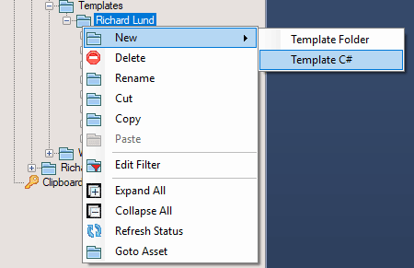
Create Site Configuration Template
Open Visual Studio
Click the Folder icon on the CP add-in
Navigate to
  Training
  Developer Training
  Project
  Templates
  [Folder with your name]
Right-click on the folder
New > Template C#
Enter “Site Config” for the name

Slide 9
Create Site Configuration Input Template
Double-click on input.aspx file
Add code to capture the header logo
Input.ShowAcquireImage(
"Header Logo", "header_logo");
Add code for a panel
while (Input.NextPanel( "header_links")) { }
Add code inside the while loop to capture the name and link
Input.ShowTextBox("Link Name", "link_name");
Input.ShowAcquireDocument("Link", "link");

Slide 10

Create Site Configuration Asset
In Crownpeak V3, navigate to
  Training
  Developer Training
  [Folder with your name]
Choose File > New > File from menu
Enter the name as “_Site Config”
Click on the radio beside “Template”
Click the to go to the root, then …
Find the template you just created
  Click OK on the lightbox
Select “Basic Workflow”
  Click Create

Slide 11
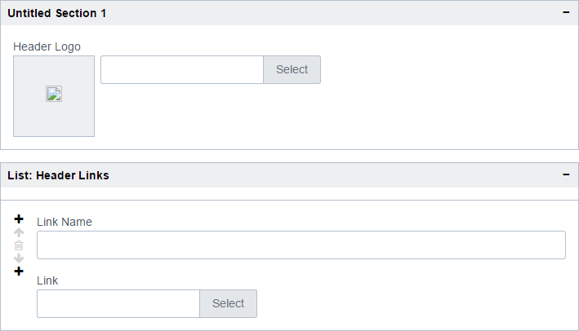
Edit Site Configuration Asset
If you saw a green popup, and the asset has appeared in the file view, all is well!
Double-click on your new asset to open preview
  It’ll be blank – we haven’t written an output template
Click to enter Form View
Click to expand the boxes and see what you made

Slide 12
So far, so good…
That’s the header, now for the footer
How should we separate the sections?
What else might we need:
  HTML title (Crownpeak | Home)
  Copyright message
  …?
Make changes in Visual Studio then return to V3 and refresh to test
You might need:
  Input.ShowAcquireImage()
  Input.ShowAcquireDocument()
  Input.ShowTextBox()
  Input.NextPanel()
  Input.StartTabbedPanel()
  Input.NextTabbedPanel()
  Input.EndTabbedPanel()
  Input.ShowMessage()

Slide 13
Improving usability
The image picker starts in the same folder every time
  That could get really annoying!
The signature for Input.ShowAcquireImage takes a ShowAcquireParams object
var showAcquireParams = new ShowAcquireParams {
DefaultFolder = "/Training Sandbox/Developer Training/_Assets/images"
};
Input.ShowAcquireImage("Header Logo", "header_logo", showAcquireParams);
Repeat for the other uses, and test it again
  Much better!
Notes:
Extra credit:
second object to provide a default for the document picker
avoid hard-coding the site path

Slide 14
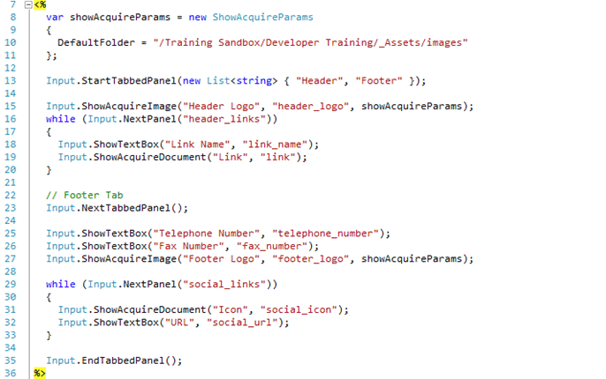
Finished Site Configuration Template

Slide 15
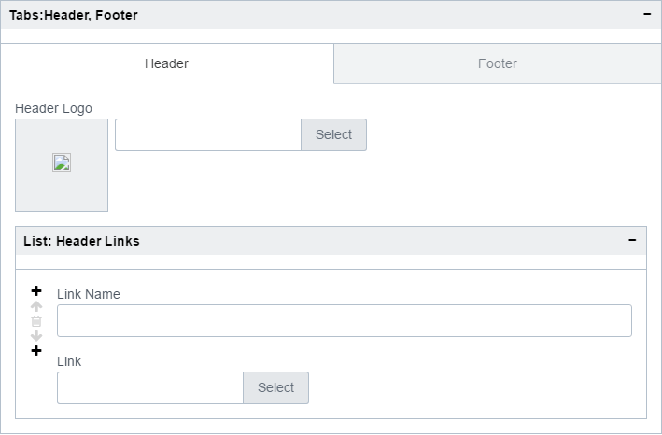
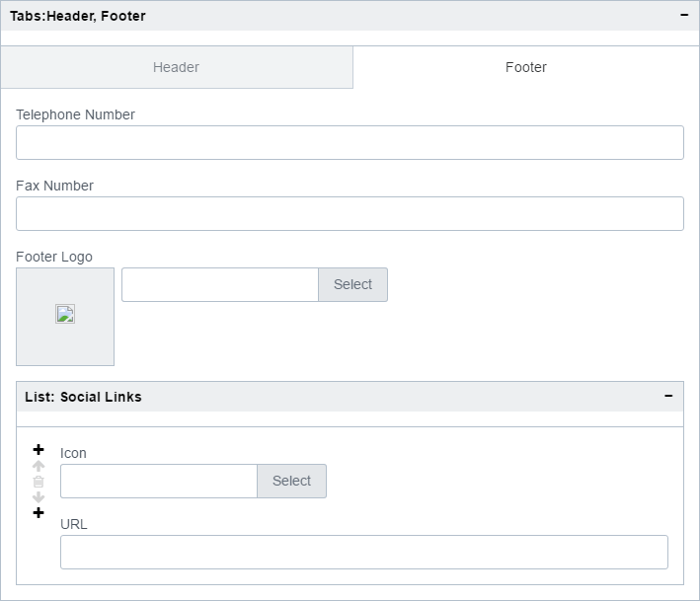
Finished Site Configuration Template

Slide 16
One last change…!
We don’t want the Site Configuration asset to publish a file
Right-click on the template
  New > Filename.aspx
  Open the file
context.PublishPath = "";
We could have manipulated the filename here instead of clearing it
We also have url.aspx
  Could publish no file
  Set url of product.aspx?id=1234
Also have assetfilename.aspx
  And asseturl.aspx

Slide 17
Navigation Wrapper

Slide 18
Navigation Wrapper
The purpose of the Nav Wrap is to draw the boilerplate that’s on all pages
We need to grab the header and footer markup from the example page
View the source of the page
  Header goes from <!DOCTYPE html> to </header>
  Footer goes from <footer> to </html>

Slide 19
Create Navigation Wrapper Template
Right-click on your folder
Create a new template
  “Navigation Wrapper”
Open output.aspx
In V3, find the ID of your Site Config
  Tip: Expand the File View
“asset” refers to the current asset
We need to refer to _Site Config
var config = Asset.Load(1012589);
In the real world you’d use a path
  Because ID changes after branch

Slide 20
Create Navigation Wrapper Output Template
Paste the header HTML
Add the content placeholder… can you remember?
<%= Out.GetWrapContentPlaceholder() %>
Append the footer HTML
Now we can replace the fixed items with values from the Site Configuration

Slide 21
Create Navigation Wrapper Output Template
Look for
  <img src="/classic/_assets/images/nav-logo.png" class="nav-logo"/>
  <ul class="nav-links">
  <li>
  <a href="/classic/standard-home-video.html">Home 1</a>
  </li>
  ...
  </ul>
Repeat for the other fields
Replace with
  <img src="<%= config["header_logo"] %>" class="nav-logo"/>
  foreach (var panel in config.GetPanels("header_links"))
  {
  Out.WriteLine("<li><a href=\"{0}\">{1}</a></li>", panel["link"], panel["link_name"]);
  }
Note: keep the <ul> and </ul>

Slide 22
Create Navigation Wrapper Output Template
Next we need to fix the CSS, JavaScript links and images to refer to CMS assets
  This makes the preview work properly, and is definitely best practice
Make helper variables:
  var root = "/Training Sandbox/Developer Training/";
  var me = root + "Richard Lund/";
  var assets = root + "_Assets/";
Look for CSS references and replace the whole line with
  <% =ServicesOutput.RenderCSSLink(assets + "css/style.css") %>

Slide 23
Create Navigation Wrapper Output Template
Look for JavaScript references and replace the whole line with
  <%= ServicesOutput.RenderScriptLink(assets + "js/util.js") %>
Look for images and replace the src attribute like the following
  <img src="<%= Asset.Load(assets + "images/nav-button-open.png").GetLink() %>" class="expand" />
If you find anything else… use your skill and judgement!

Slide 24
Simple Page Template

Slide 25

Create Simple Page Template - Input
In Visual Studio:
  Right-click
  Choose New > Template C#
  “Simple Page”
Open input.aspx
Capture a text field for the page title
… and a WYSIWYG field for the body
You will need:
  Input.ShowTextBox()
  Input.ShowWysiwyg()
  ServicesInput.FullWYSIWYG()
Notes:
Extra credit:
CSS for wysiwyg

Slide 26

Create Simple Page Template - Validation
Add some validation
In Visual Studio:
  Right-click on your template folder
  Choose New > post_input.aspx
Open the post_input.aspx file
Add code to check for the title field
You will need:
  context.InputForm.HasField()
  context.ValidationErrorFields
You can be much cleverer than this if you like!
Notes:
Extra credit:
Certain number of characters in the title
Rename the asset with the title

Slide 27
Create Simple Page Template - Output
Open output.aspx
Create some simple markup to display your fields
<h1><%= asset["title"] %></h1>
<%= asset["body"] %>
Note that the WYSIWYG field needs no extra markup
Create a new file in the CMS
  Simple Page
Choose your “Simple Page” template
Select the “Basic Workflow”
Open it and add some data
Save and preview!
It works, but we have no wrapper

Slide 28
Create Simple Page Template - Output
Wrap your output with your Navigation Wrapper… can you remember how?
<% Out.Wrap("/Training Sandbox/Developer Training/Project/Templates/[Your Name]/Navigation Wrapper"); %>
Finally you can refresh your preview
It works! Though it could be better.
  Wrap your output with <section><div class="wrapper">
  Refresh again
The links aren’t showing because they’re not linked yet – fix it!

Slide 29
Widget Template

Slide 30
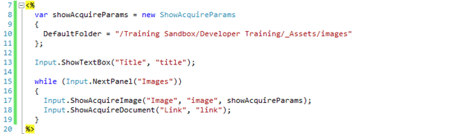
Create Widget Template - Input
In Visual Studio:
  Right-click
  Choose New > Template C#
  “Widget”
Open input.aspx
Capture a text field for the title
And a panel containing an image and an internal link
You will need:
  Input.ShowTextBox()
  Input.ShowAcquireImage()
  Input.ShowAcquireDocument()
Notes:
Extra credit
Alt text for image
Default folder for image
Default folder for document

Slide 31
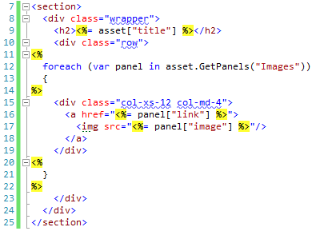
Create Widget Template - Output
Open output.aspx
Wrap the output in a section
And a div.wrapper and div.row
Loop through and display the panels
Wrap each in div.col-xs-12.col-md-4
Notes:
Extra credit:
alt text for image
don’t output panel if no image is picked

Slide 32

Create Widget Asset
Create a new file in the CMS
  Name it “Widget”
  Pick your Widget template
  Select the Basic Workflow
Go to the Form view and enter data
Save and preview
It worked… sort of!
  There’s no header or footer
  But a widget doesn’t have one

Slide 33

Improve Widget Template - Preview
The widget isn’t wrapped
  Because we don’t need that
We can show a different preview
Right-click and New > preview.aspx
Open preview.aspx
Use Out.Wrap() and asset.Show()
It works! And it’s responsive!

Slide 34
Add a widget to the Simple Page Template

Slide 35
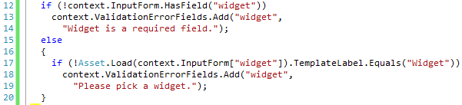
Update Simple Page Template
Open input.aspx for Simple Page
Add a control to pick a widget
Open output.aspx
Add output for the widget
  Use Asset.Load()
  And the .Show() method
Validate that they picked a widget?
  What template did they pick?
Input.ShowAcquireDocument("Widget", "widget");
<%= Asset.Load(asset["widget"]).Show() %>

Slide 36
Improving the User Experience

Slide 37
Improving the User Experience
Content authors do not typically have permission to use New > File in the CMS
Doing so would let them pick templates not designed for your site
Or the wrong workflow
Let’s move our assets around and create some models to help authors

Slide 38
Creating Models
In V3, navigate to Project / Models / [Your name]
Right-click and choose New > Folder
Name it “Pages”
Navigate into the Pages folder
Right-click and choose New > File
Name it “Simple Page”
Choose the Simple Page template and the Basic Workflow
In a minute we’ll repeat the steps to add a folder called “Widgets”
We won’t make one for Site Config
  Why not?

Slide 39
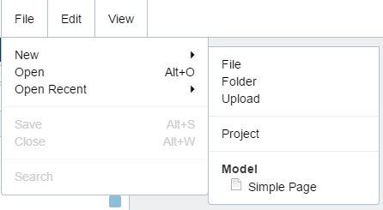
Assigning Models
Navigate to your folder
  Select it
In the Properties panel, click Model
Click Browse and pick the “Pages” folder you just created
  NOTE: not the file!
  Click OK to apply the change
Models are cached, so log out of V3
Log back in again and navigate to your folder
Try the New menu
Notes:
Extra credit:
add a second type to the model - Widget
make a recursive model

Slide 40
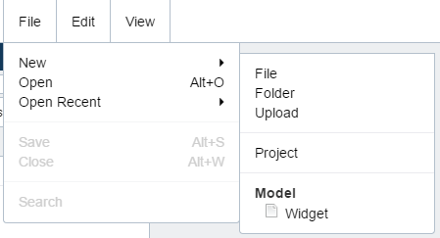
Assigning Models
Make a new folder (not in Models)
  Call it Widgets
  Move your widget into the folder
  (You might get an error here!)
Now make another model as before
  Call the folder “Widgets”
  Call the file “Widget”
  Pick the Widget template
  And the Basic Workflow
Assign the model to the Widgets folder you just created
Log out and back into V3

Slide 41
Thank You!

